Slide 1
MELANOMA DETECTION BASED ON DEEP NEURAL NETWORKS
Leveraging AI for early skin cancer diagnosis
Name | Student ID
Abhishek Shrinivas Joshi | 1002050821
Lakshmi Ganapathi Nukala | 1002060514
Tirupathirao Naga | 1002077760
Under Guidance of:
Prof. Rozsa Zaruba

Slide 2
INTRODUCTION
Melanoma, a type of skin cancer from melanin-producing cells.
Most aggressive forms of skin cancer
Spreading rapidly if not treated early.
Characteristics include asymmetry, irregular borders, varied coloration, and evolving features in moles.

Slide 3
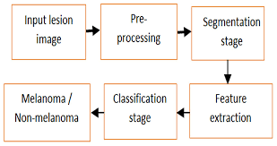
Project description
Dataset - Kaggle - 10000 images – both for training and testing purpose
Convolutional Neural Network (CNN) architecture will be used
The goal of this project is to utilize the melanoma dataset to develop a deep learning model for melanoma detection from scratch and compare its working with various pre-trained models namely VGG16 and ResNet 50algorithm.
Various evaluation metrics are planned to be used involving:
Sensitivity
Specificity
Precision
Accuracy
F1 - Score

Slide 4
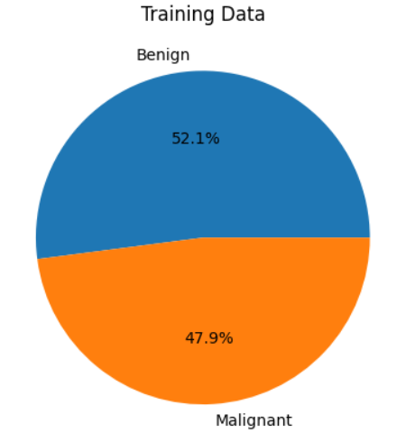
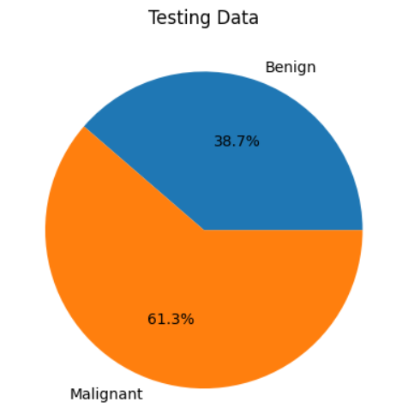
DATA LOADING

Slide 5
PREPROCESSING
DATA AUGMENTATION : Increase the diversity of your training dataset, helps generalize better to unseen data and reduces overfitting.
NORMALIZATION : Ensures all images have the same dimensions
NOISE REDUCTION : Gaussian blur is be used to smooth out images and reduce noise

Slide 6
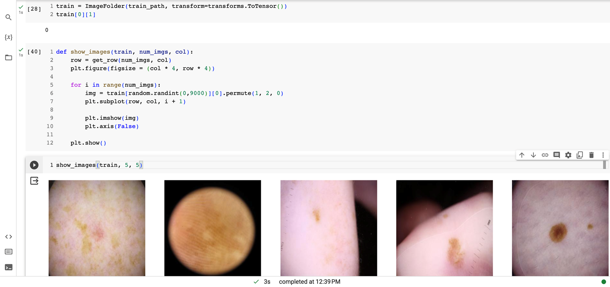
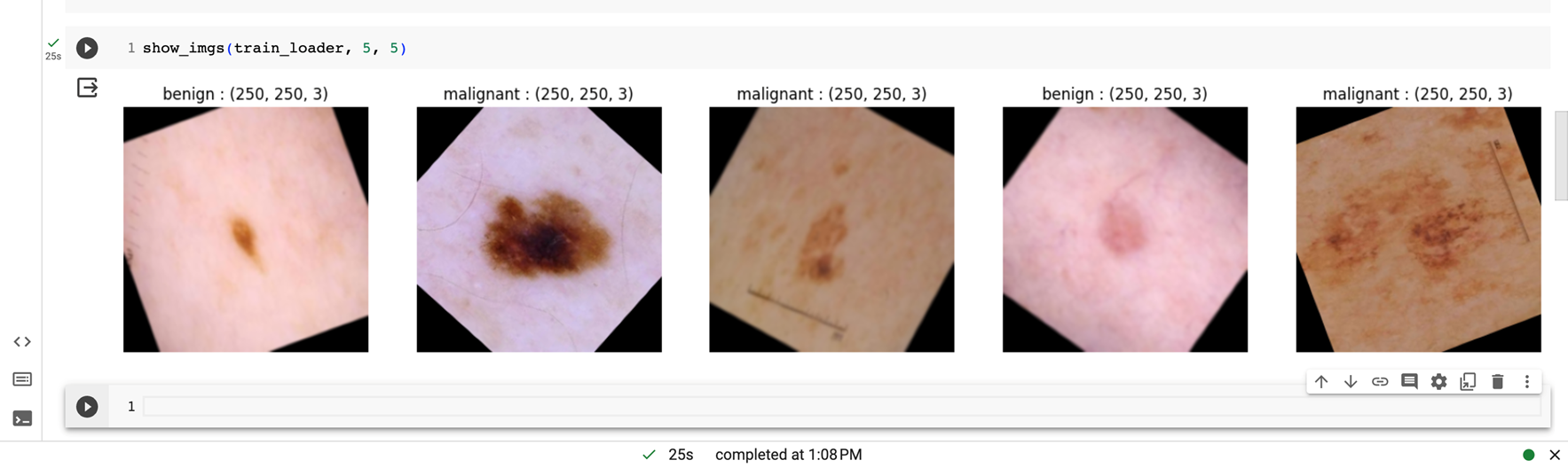
PREPROCESSING
IMAGES BEFORE AUGMENTATION
IMAGES AFTER AUGMENTATION

Slide 7
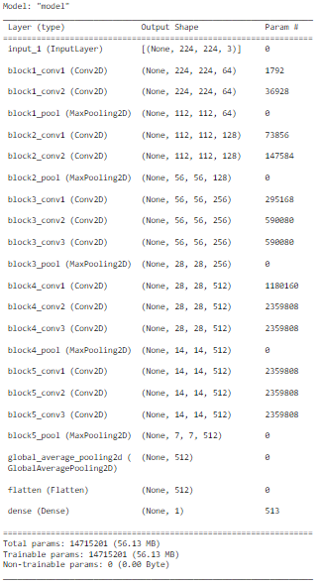
VGG16 MODEL ARCHITECTURE

Slide 8
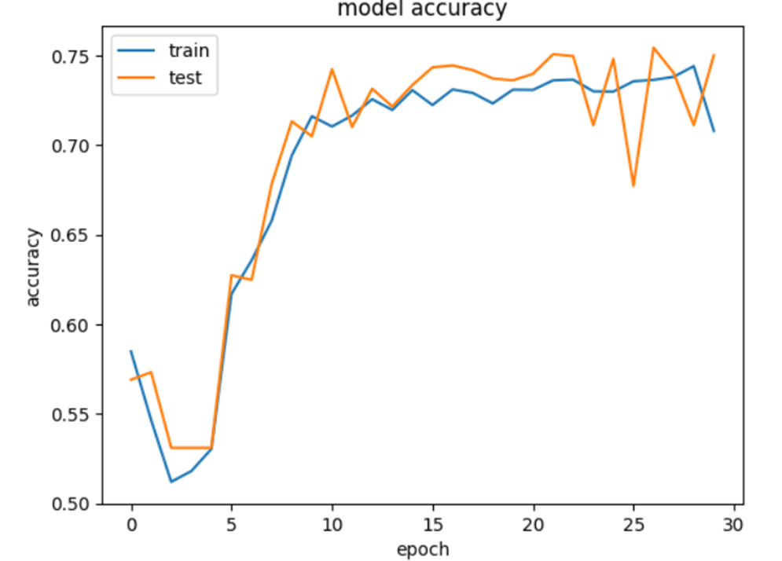
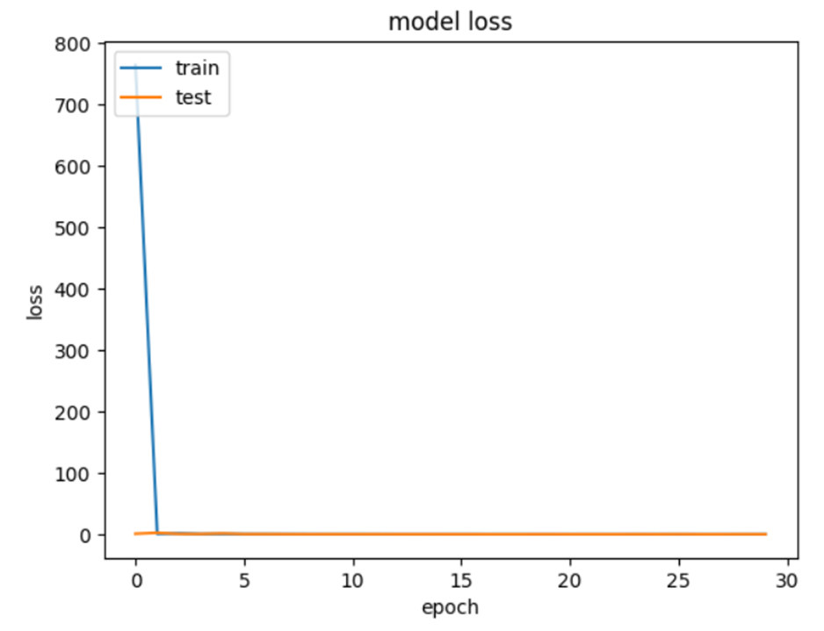
VGG 16 MODEL FITTING

Slide 9
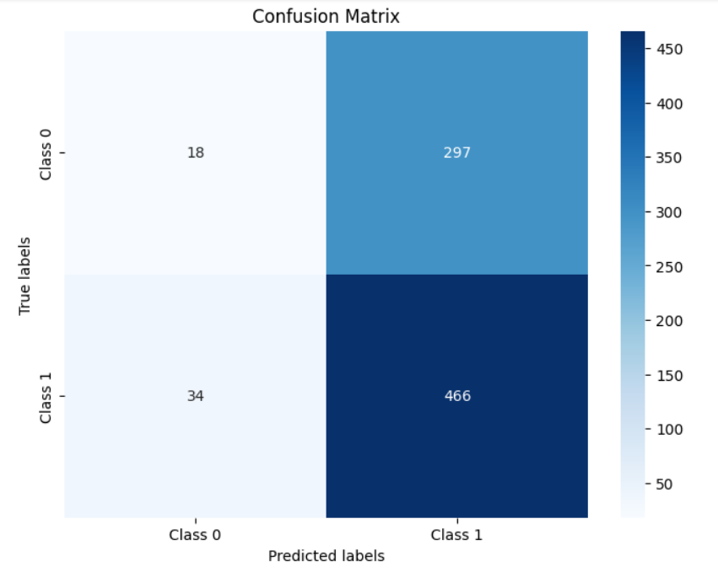
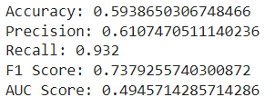
VGG 16 METRIC EVALUATION
Accuracy for the VGG 16 model was around 59.39 %

Slide 10
Advantages and Disadvantages
Advantages :
Simple architecture with only 3x3 convolutional layers and max-pooling layers.
Easy to understand and implement.
Good performance on small to medium-sized datasets.
Disadvantages :
Deep architecture with many parameters, making it computationally expensive and memory-intensive.
Prone to overfitting, especially on smaller datasets.
May struggle with learning intricate features due to its fixed depth and uniform architecture.

Slide 11
ADDITION OF SVM OUTPUT LAYER
Improved Generalization
Handling nonlinearity
Interpretability
Ensemble effect

Slide 12
VGG16 WITH SVM OUTPUT LAYER
Epoch 30/30
121/121 [==============================] - ETA: 0s - loss: 0.6580 - accuracy: 0.7078
Epoch 30: val_loss did not improve from 0.50379
121/121 [==============================] - 98s 811ms/step - loss: 0.6580 - accuracy: 0.7078 - val_loss: 0.5239 - val_accuracy: 0.7501 - lr: 0.0030
dict_keys(['loss', 'accuracy', 'val_loss', 'val_accuracy', 'lr'])

Slide 13
VGG 16 MODEL FITTING

Slide 14
VGG 16 WITH SVM Accuracy
32/32 [==============================] - 3s 108ms/step Accuracy: 0.7

Slide 15
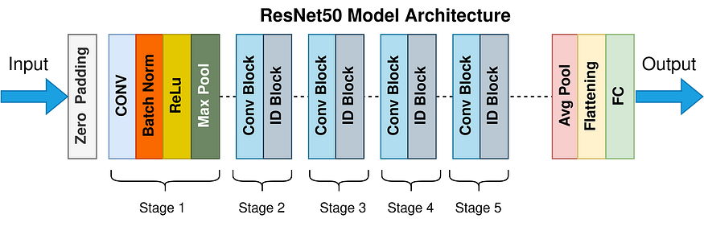
RESNET 50 ARCHITECTURE
Input Size: 224x224x3
Output Size: 2048
Model Summary:
Layer 1-48: Residual Blocks
Each block contains a series of convolutional layers with shortcut connections.
These connections help mitigate the vanishing gradient problem, allowing for deeper networks.
Layer 49: Global Average Pooling
Reduces the spatial dimensions of the feature maps to 1x1.
Aggregates the features across the spatial dimensions.
Layer 50: Dense Layer
Output Size: 2048
Combines the features from the previous layers into a final representation.
Activation function (typically ReLU) applied to introduce non-linearity.
After this a dense layer was added with output size 1.

Slide 16
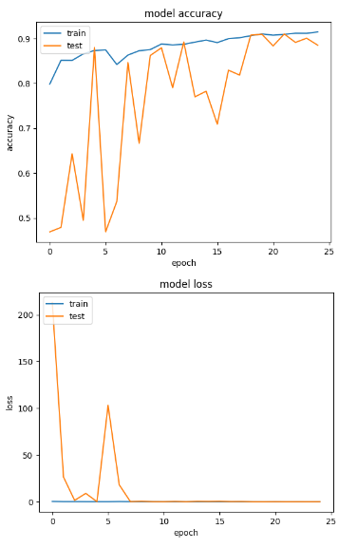
Resnet 50 MODEL FITTING

Slide 17
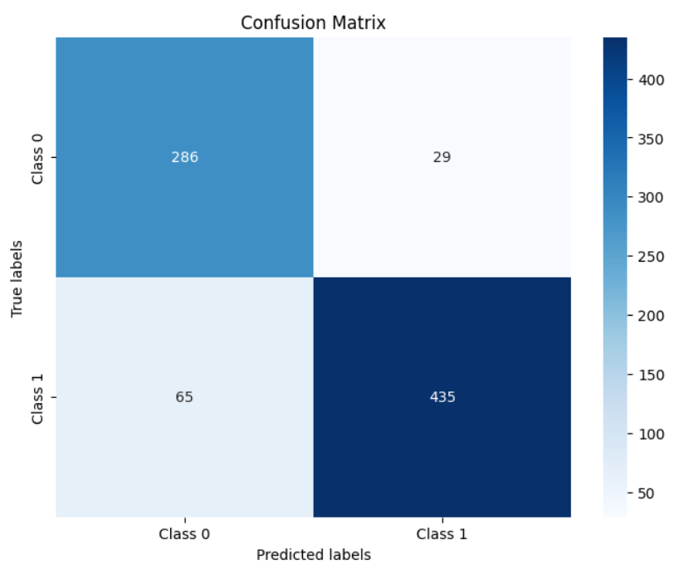
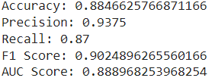
Resnet 50 METRIC EVALUATION

Slide 18
Advantages and Disadvantages
Advantages :
Utilizes skip connections or shortcuts, which help alleviate the vanishing gradient problem and enable training of very deep networks.
Achieves state-of-the-art performance on various image classification tasks.
Relatively lightweight compared to other deeper architectures, making it more efficient for deployment.
Disadvantages :
More complex architecture compared to VGG16, which can make it harder to interpret and implement.
May require more computational resources for training and inference compared to shallower networks.

Slide 19
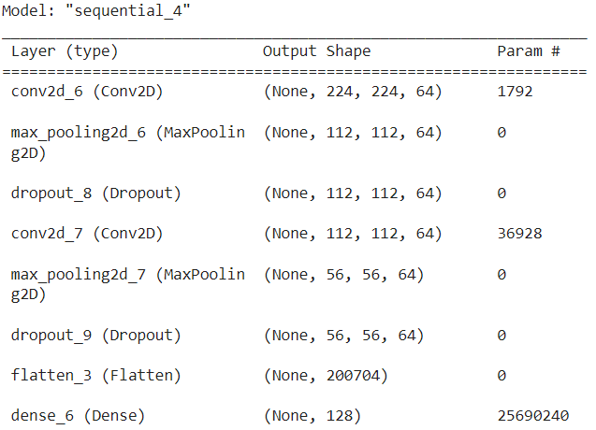
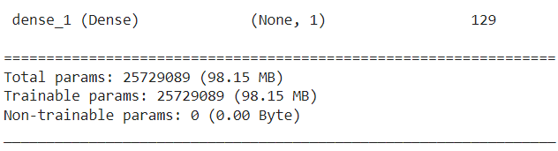
SHALLOW HYBRID CNN ARCHITECTURE

Slide 20
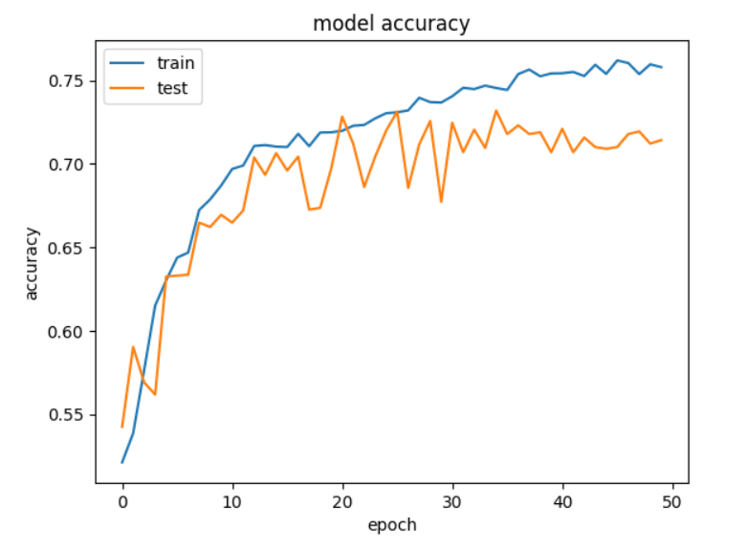
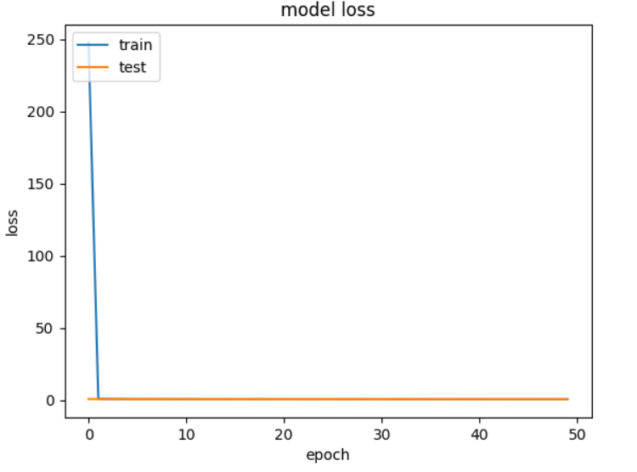
SHALLOW HYBRID MODEL FITTING

Slide 21
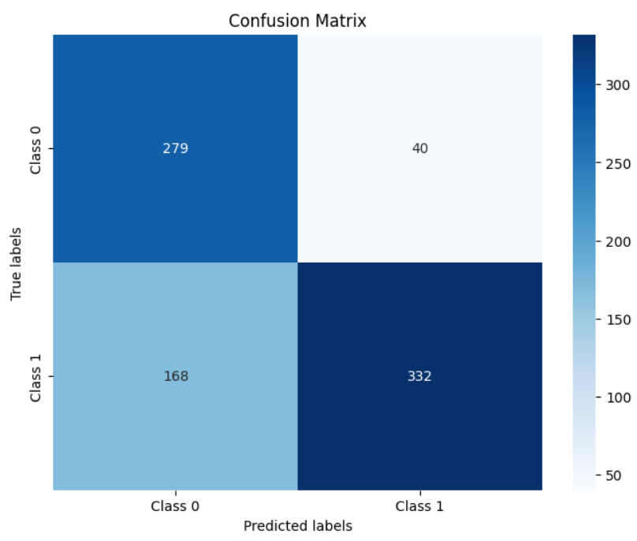
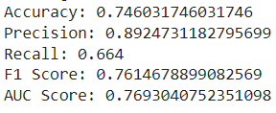
SHALLOW HYBRID METRIC EVALUATION

Slide 22
Advantages and Disadvantages
Advantages :
Simplicity in architecture, making it computationally efficient and easier to interpret.
Respectable performance, particularly in precision and F1 score.
Faster training times compared to deeper architectures like ResNet-50.
Disadvantages :
Lower accuracy compared to ResNet-50 and the Complex Hybrid Model.
Limited capacity to learn intricate features due to its shallower architecture.

Slide 23
COMPLEX HYBRID CNN ARCHITECTURE
Input Layer:
Shape: `(224, 224, 3)` (input_shape)
This layer specifies the input shape for the images fed into the network.
2. Convolutional Layers:
- Conv2D (64 filters):
Kernel Size: `(3, 3)`
Padding: 'same'
Activation: ReLU
Kernel Initializer: He normal initialization
- Batch Normalization: Applied after each convolutional layer to normalize the activations and accelerate training.
- MaxPooling2D:
Pool Size: `(2, 2)`
Stride: Default (which is also `(2, 2)`)
Performs max pooling to reduce spatial dimensions.
- Dropout:
Rate: 0.25
Helps prevent overfitting by randomly dropping 25% of the units.
3. Subsequent Convolutional Blocks
Similar structure as the first block with increasing number of filters: 128, 256, and 512.
Each block consists of Conv2D, BatchNormalization, MaxPooling2D, and Dropout layers.
4. Flattening Layer:
Flattens the 3D feature maps into a 1D feature vector to prepare for the fully connected layers.
5. Dense (Fully Connected) Layers:
Dense (1024 units):
Activation: ReLU
Kernel Initializer: He normal initialization
Batch Normalization and Dropout:
Applied after the dense layer to regularize the network.
6. Additional Dense Layer:
Dense (512 units):
Activation: ReLU
Kernel Initializer: Helps normal initialization
Batch Normalization and Dropout:
Applied similarly to the previous dense layer.
7. Final Dense Layer:
Dense (128 units):
Activation: ReLU
Kernel Initializer: He normal initialization
This layer serves as the final output layer before returning the model.

Slide 24
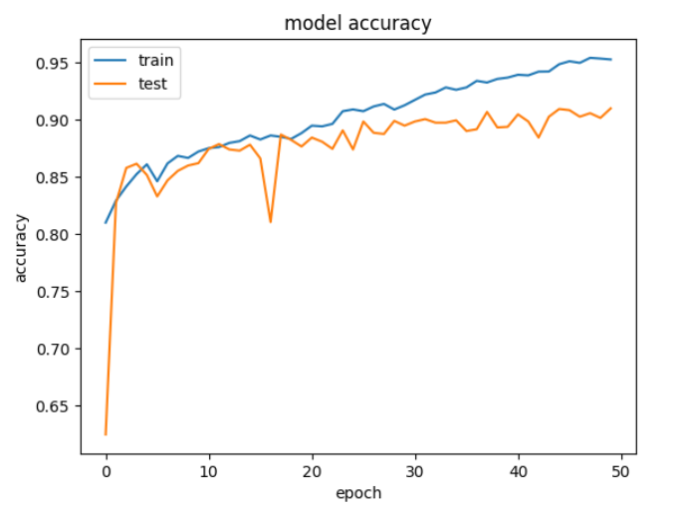
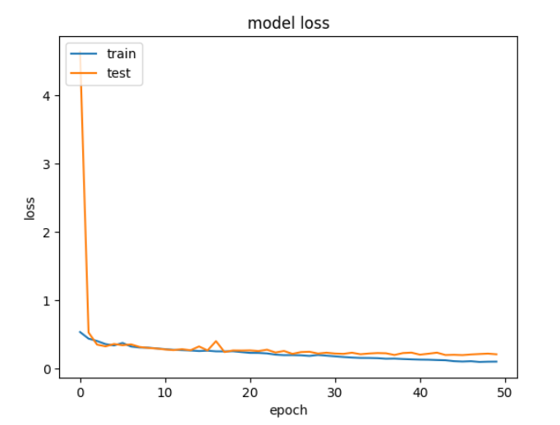
COMPLEX HYBRID MODEL FITTING

Slide 25
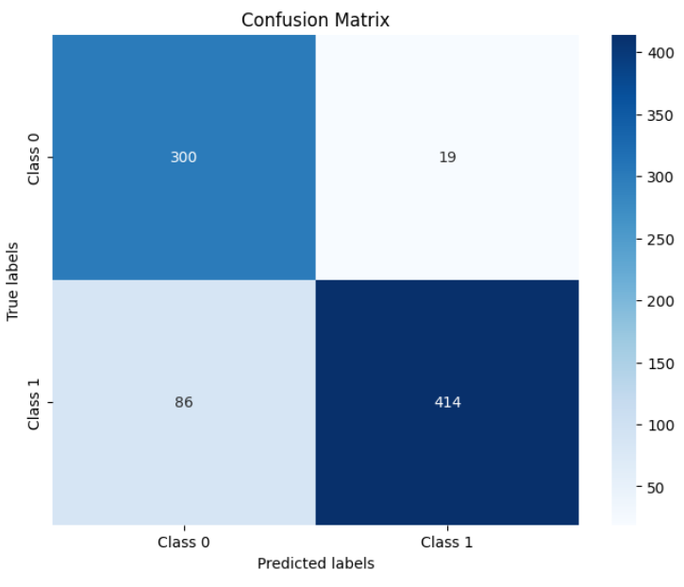
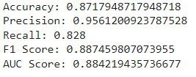
COMPLEX HYBRID METRIC EVALUATION

Slide 26
Advantages and Disadvantages
Advantages :
High precision, indicating strong capability in correctly identifying positive cases.
Good overall performance across various evaluation metrics, comparable to ResNet-50.
Potential for customization and fine-tuning to suit specific requirements or datasets.
Disadvantages :
Complexity in architecture, which may result in longer training times and increased computational resources.
Requires careful hyperparameter tuning to achieve optimal performance.

Slide 27
CONCLUSION
Both of our custom models showcase promising performance, particularly when compared to the pre-trained VGG16 model.
The Complex Hybrid Model exhibits high precision, indicating its effectiveness in correctly identifying positive cases, comparable to the performance of ResNet-50 in terms of precision.
While the Shallow Hybrid Model falls short in accuracy compared to ResNet-50, it demonstrates robustness in precision and F1 score, suggesting its potential for specific applications where precision is crucial.
Our models show potential for further fine-tuning to match or even surpass the accuracy of ResNet-50 while maintaining or improving upon the precision and robustness of both ResNet-50 and VGG16.

Slide 28
FUTURE SCOPE
A streamlit application can be used to create a user interface.
The OpenCV library can be used to take the pictures.
Our COMPLEX HYBRID Model can be used to post predictions to the user interface.

Slide 29
REFERENCES
Singha, S.; Roy, P. Skin Cancer Classification and Comparison of Pretrained Models Performance using Transfer Learning. Preprints 2022, 2022090215. https://doi.org/10.20944/preprints202209.0215.v1
https://www.kaggle.com/datasets/hasnainjaved/melanoma-skin-cancer-dataset-of-10000-images/data

